Slide 1
Symmetric Key Encryption

Slide 2
Overview
Content
Why do we need encryption?
Rationale behind encryption ciphers
Block cipher
AES algorithm
Encryption modes: ECB, CBC, CTR
Cryptanalysis
After this module, you should be able to
explain the rationale behind encryption and various types of encryption methods
explain what is cryptanalysis
One-time pad
use symmetric key ciphers

Slide 3

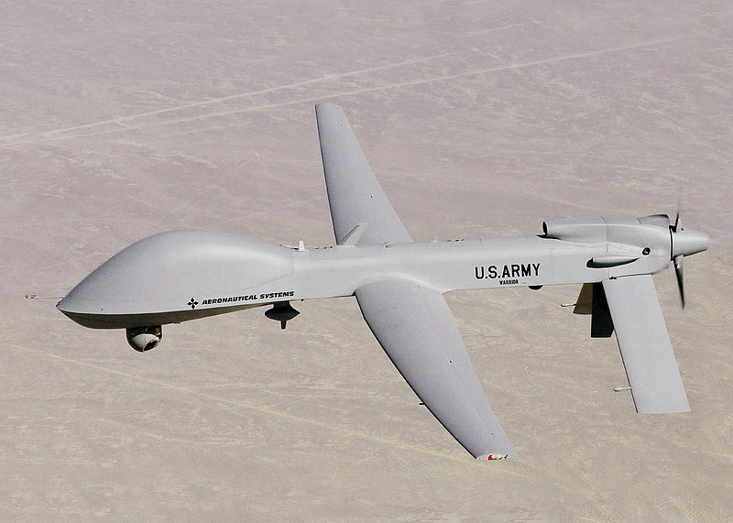

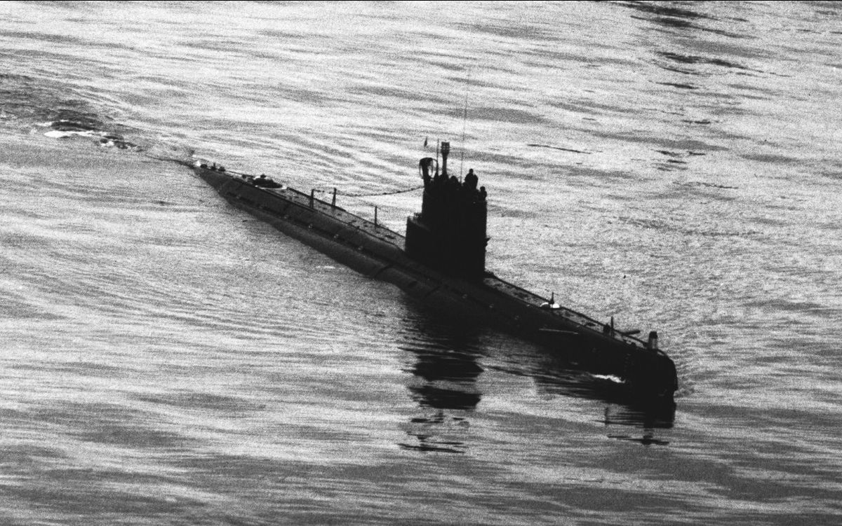
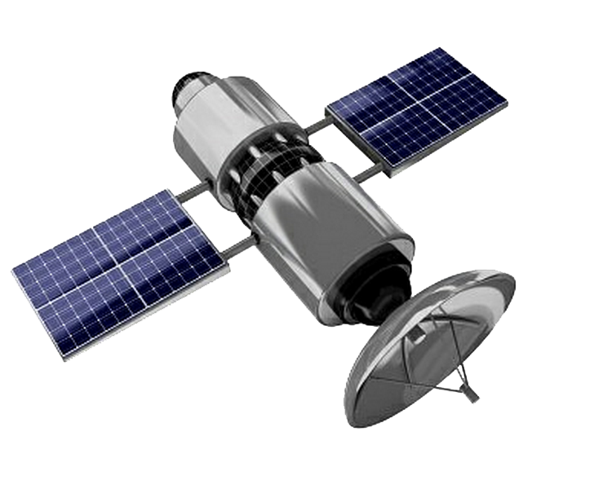
Motivation: Confidentiality is crucial

Slide 4
Motivation
The sender has no (physical) control of communication data once they leave the platform.
  No exclusive communication channel
Cannot prevent the adversary from accessing the data

Slide 5
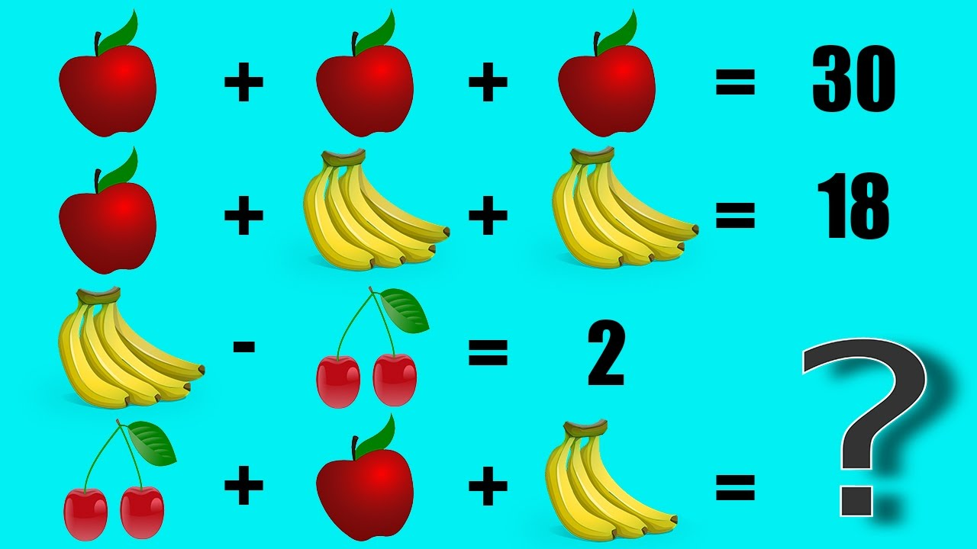

Slide 6




Rationale of Encryption
Information semantics and representation are different.
  We recognize semantics from representations by using patterns.
  Different ways of representations have different patterns.
IF the adversary cannot find patterns, it gets a hard time to extract semantics from a given representation.
“Two”, “2”, “贰” , “два”, “dos”, “dua”, “ezimbil”

Slide 7

Rationale of Encryption
GOAL: to make the ciphertext without patterns recognizable to the adversary.
  Ideally, the ciphertext is random, i.e., no pattern!
Approach 1: substitution
  Substitution can be made on the symbol set or on a fixed sized group of symbols.
  E.g., “A” → “132”, “B”→ “888 ”, ...
Approach 2: shuffle or permutation
  Rearrange the symbols to different positions in the ciphertext.
But, we need a way to get back the original data!!

Slide 8
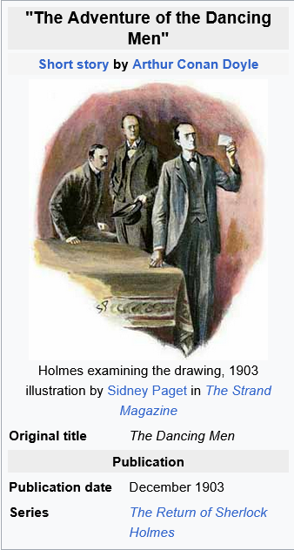
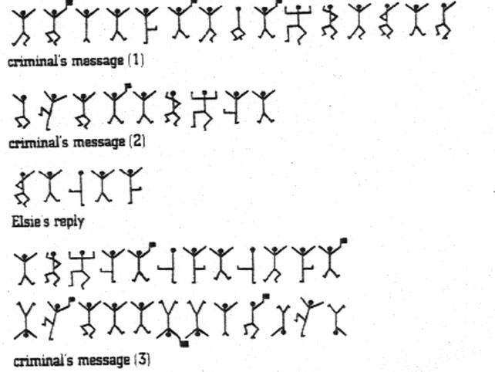




Substitution – an example
https://cryptological.wordpress.com/2018/01/06/sherlock-holmes-the-dancing-men/

Slide 9

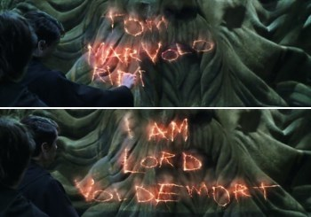
Permutation – an example
TOM MARVOLO RIDDLE
Harry Potter and the Chamber of Secrets (2002)

Slide 10




Encryption/Decryption
message
ciphertext
Encryption
algorithm
Decryption
algorithm
ciphertext
message

Slide 11
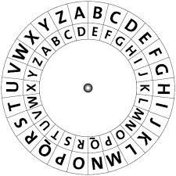
Caesar Cipher
Julius Caesar 2000 years ago
Substitution: a letter is replaced by another letter (the original Caesar cipher is a shift cipher)
Notes:
Shift cipher, basically A map to B etc.

Slide 12
What is the original message?
Fubswrjudskb lv dq lqwhuhvwlqj vxemhfw
Cryptography is an interesting subject

Slide 13
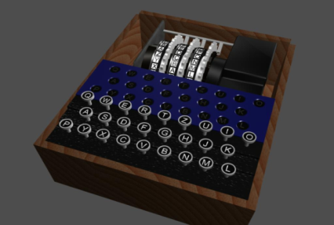

German Enigma Machine: Character Substitution
The longest "darkness" period was with the German Navy's Enigma machine, which could not be deciphered for four years between 1937-1941.
An Enigma Demo
https://www.101computing.net/enigma-encoder/

Slide 14
Can we go to the extreme of substitution?
Randomly chosen substitution
Same Set of Messages of a fixed length
Notes:
???

Slide 15
One-Time Pad (a.k.a. Vernam Cipher)
  P: a bitstring (aka binary string) representation of the plaintext (i.e. message)
  K: a random bitstring with the same length as the plaintext
  Every encryption uses a new freshly chosen key.
Plaintext
Exclusive OR
Ciphertext
Exclusive OR
Plaintext
P
C
P
Secret channel
K
K
Notes:
Vernam Cipher
Plain text + a key that is of SAME LENGTH as the plain text.
XOR them.

Slide 16




One-time pad
Exclusive OR operations
An example of Vernam Cipher
  Alice:
  Bob:
1 ⊕ 0 = 1; 0 ⊕ 1=1
0 ⊕ 0 =0; 1 ⊕ 1=0
P: 100 010 111 011 110 001…
Perfectly/Unconditionaly secure: unbreakable even with infinite amount of computational power, assuming the attacker has no knowledge about the key
K: 010 011 101 101 010 111…
C: 110 001 010 110 100 110…
Impractical: The need for synchronization & the need for an unlimited number of keys
C: 110 001 010 110 100 110…
K: 010 011 101 101 010 111…
P: 100 010 111 011 110 001…

Slide 17
Message in Binary
Dec | Hex | Binary | Symbol
65 | 41 | 01000001 | A
66 | 42 | 01000010 | B
67 | 43 | 01000011 | C
68 | 44 | 01000100 | D
69 | 45 | 01000101 | E
70 | 46 | 01000110 | F
71 | 47 | 01000111 | G
72 | ? | ? | H
73 | ? | ? | I
74 | ? | ? | J
ASCII Character to Binary Conversion
https://www.youtube.com/watch?v=5aJKKgSEUnY

Slide 18
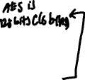
Block Ciphers
Block Ciphers are for binary messages.
  Text messages are also binaries when they are processed by computers.
A block is a fixed number of consecutive bits in the message as
  Intuitively, blocks are like words in our dictionary, except that blocks are of the same length.
To encrypt a message, make substitutions upon each block in the message with another block chosen from the block domain (i.e., the set of all possible blocks.)
The cipher algorithm and the key jointly define the mapping between plaintext blocks and ciphertext blocks.
Notes:
!!!!

Slide 19





A Toy Example (my invention!)
000
001
010
011
100
101
110
111
Block size: 3 bits
Key size: 2 bits
K=01
000
001
010
011
100
101
110
111
Key Challenge: How to define the mapping and let the software to use the mapping?
000
001
010
011
100
101
110
111
K=10
000
001
010
011
100
101
110
111
plaintext
ciphertext
K=01
000110110011010001
010001001111011000

Slide 20
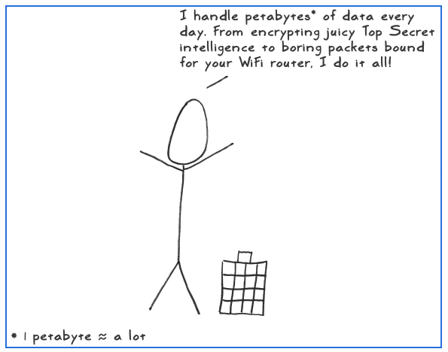



Advanced Encryption Standard (AES)
Advanced Encryption Standard (AES)
AES key size: 128, 192, 256 bits
AES block size: 128 bits
Unclassified, publicly disclosed, royalty-free
Internal steps of AES (not required)
A very interesting illustration of AES

Slide 21
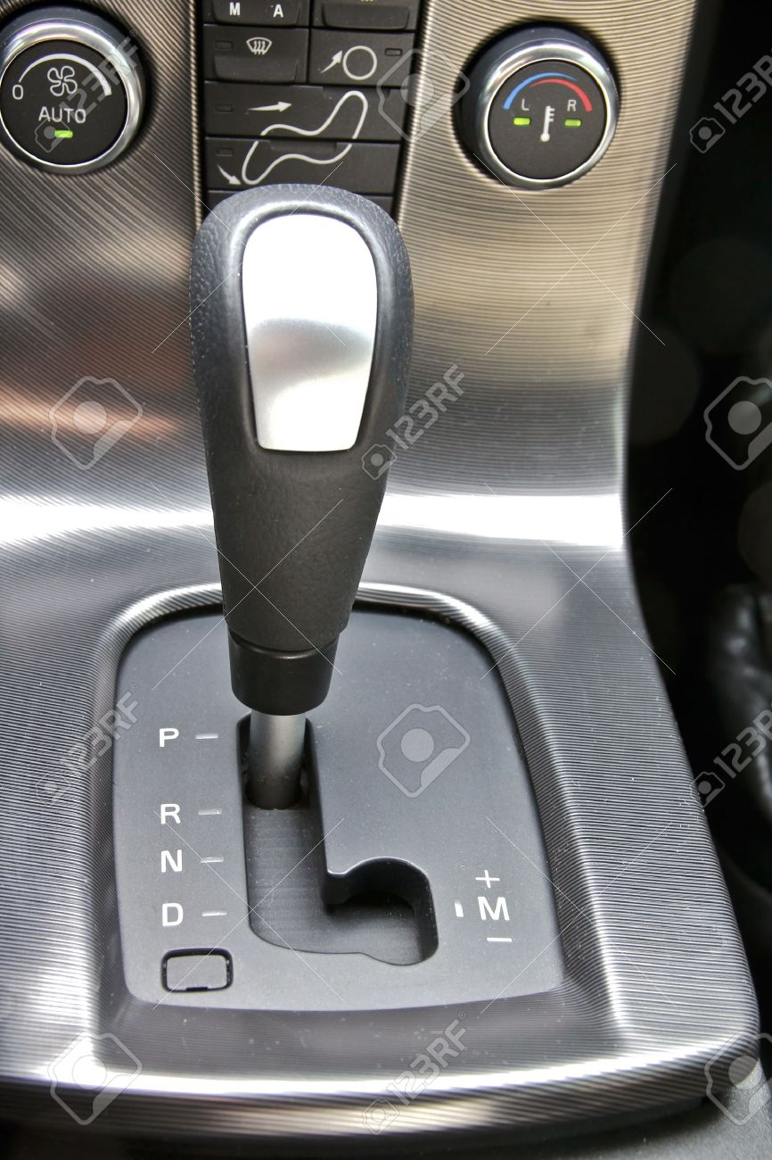
Modes of Encryption
AES is a block cipher. The algorithm and the specific key determine a mapping between blocks.
Symmetric key encryption: use a block cipher to encrypt a message consisting of multiple blocks.
  Should the relation among blocks be considered?
Three modes to encrypt messages.
  ECB: Electronic Code Book
  CBC: Cipher Block Chaining
  CTR: Counter
The block cipher key only specifies the plaintext-ciphertext block mapping. It does not deal with the relation among blocks, i.e. mode of encryption.

Slide 22
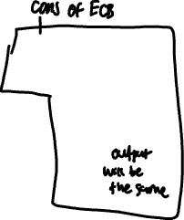

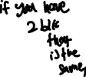
ECB Mode
Plaintext
BLK1
BLK2
BLK3
Key: k
BLK1
BLK2
BLK3
k
Cipher
k
Cipher
k
Cipher
Ciphertext
CBLK1
CBLK2
CBLK3

Slide 23
CBC Mode
Before applying AES upon the plaintext, a random block is chosen as the Initial Vector (IV).
  The length of IV is the same as the block size
IV needs NOT be a secret.
IV is considered as the first block in the ciphertext.
The purpose of IV:
  to introduce randomness into the encryption process

Slide 24
CBC Mode
The first block has index 1
Encryption
  C_{i}=Enc_{k}(P_{i}⊕C_{i-1}), C₀=IV
Decryption
  P_{i}=Dec_{k}(C_{i}) ⊕C_{i-1}, C₀=IV
Encryption must be sequential and decryption can be parallel.

Slide 25



CBC Mode Encryption
Plaintext
BLK1
BLK2
BLK3
Key: k
BLK1
BLK2
BLK3
Initial Vector (IV) is freshly chosen for every plaintext encryption
Initial
Vector
XOR
XOR
XOR
k
Cipher
k
Cipher
k
Cipher
Ciphertext
Initial
Vector
CBLK1
CBLK2
CBLK3
CBLK_{i}=Cipher_{K}( BLK_{i} ⊕ CBLK_{i-1} ), CBLK₀=IV

Slide 26
CBC – A toy example (encryption)
Let us consider a toy 3-bit block cipher with the following mapping:
Plaintext Block | 000 | 001 | 010 | 011 | 100 | 101 | 110 | 111
Ciphertext Block | 111 | 110 | 011 | 100 | 001 | 000 | 101 | 010
CBC
IV=111
Plaintext | 101 | 101 | 110 | 010
(After XOR) | 010 | 110 | 011 | 110
Ciphertext | 011 | 101 | 100 | 101
Notes:
The plaintext block to ciphertext block is derived when we have the key

Slide 27

CBC Mode Decryption
Ciphertext
Initial
Vector
CBLK1
CBLK2
CBLK3
CBC ciphertext includes the IV used in encryption
Plaintext
BLK1
BLK2
BLK3
Initial
Vector
XOR
XOR
XOR
Cipher
Cipher
K
Cipher
K
K
CBLK1
CBLK2
CBLK3
  BLK_{i} = Dec_{K}(CBLK_{i}) ⊕ CBLK_{i-1}, CBLK₀=IV

Slide 28
CBC – A toy example (decryption)
Let us consider a toy 3-bit block cipher with the following mapping:
Plaintext Block | 000 | 001 | 010 | 011 | 100 | 101 | 110 | 111
Ciphertext Block | 111 | 110 | 011 | 100 | 001 | 000 | 101 | 010
Plaintext | 101 | 101 | 110 | 010
(before XOR) | 010 | 110 | 011 | 110
Ciphertext | 011 | 101 | 100 | 101
IV=111

Slide 29



Error Propagation in CBC Decryption
Ciphertext
Initial
Vector
CBLK1
CBLK2
CBLK3
CBLK4
Plaintext
BLK1
BLK2
BLK3
BLK4
Initial
Vector
XOR
XOR
XOR
XOR
Cipher
Cipher
K
Cipher
K
Cipher
K
K
CBLK1
CBLK2
CBLK3
CBLK4
  BLK_{i} = Dec_{K}(CBLK_{i}) ⊕ CBLK_{i-1}, CBLK₀=IV

Slide 30

CBC mode (parallel) Decryption
Plaintext
BLK1
BLK2
BLK3
Initial
Vector
XOR
XOR
XOR
AES
K
AES
K
AES
K
Ciphertext
CBLK1
CBLK2
CBLK3

Slide 31



CTR Mode Encryption
Plaintext
BLK1
BLK2
BLK3
Key: k
Initial
Vector
CTR=IV
CTR+1
CTR+2
k
Cipher
k
Cipher
k
Cipher
BLK1
BLK2
BLK3
XOR
XOR
XOR
Ciphertext
Initial
Vector
CBLK1
CBLK2
CBLK3

Slide 32
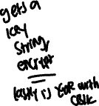
CTR Mode Decryption
Ciphertext
Initial
Vector
CBLK1
CBLK2
CBLK3
Key: k
Initial
Vector
CTR=IV
CTR+1
CTR+2
k
Cipher
k
Cipher
k
Cipher
CBLK1
CBLK2
CBLK3
XOR
XOR
XOR
Plaintext
BLK1
BLK2
BLK3
Notes:
Does not go through decrption
You just encrypt key and the IV to get a ”one-time-pad”value
Then use that value for the XOR with something else.
Since the CTR is NOT truly random, this is not perfectly secure.
OTP is TRULY secure.
In OTP, any ciphertext could correspond to any plaintext of that length → perfect secrecy.
In CTR, ciphertexts could only correspond to plaintexts that match some AES keystream. But because the AES key is so large, it’s computationally secure.
For CTR mode, if we know the length of the key, you essentially can brute force your way through to get the key values (2^4 etc). If example keystream (possible keys) is only 10,000, perhaps the amount of possible k is only 2^10? So you just have to bruteforce. IV is public but you can bruteforce the key if you know the length. But, the key is way too long so it is computationally infeasible.
Cracking key is maybe like 2^128, 2 ^192 or 2^256 etc since the key size is set. And the computational power to do it is crazy.
Size of AES keys will make it impossible to break an encryption plan.
Amount of keys vs amount of iv

Slide 33
Main Properties of Three Encryption Modes
 | ECB mode | CBC mode | CTR mode
identical plaintext blocks result in | identical ciphertext blocks | different ciphertext blocks | different ciphertext blocks
chain dependency | blocks are enciphered independently | proper encryption/decryption requires a correct preceding plaintext/ciphertext block. | blocks are enciphered independently (with an increasing counter value)
error propagation | none | a ciphertext block’s error affects decipherment of itself and the next block. | none

Slide 34

Cryptanalysis
Attacker
  Knows E and D (under what principle?)
  Given a ciphertext, the objective is to find its plaintext
  Based on
weak
Ciphertext only | Cryptanalyst only knows ciphertext
Known plaintext | Cryptanalyst happens to know some plaintext-ciphertext pairs (He cannot choose what to know.)
Chosen plaintext | Cryptanalyst knows some plaintext-ciphertext pairs for plaintext chosen by himself
Chosen ciphertext | Cryptanalyst knows some plaintext-ciphertext pairs for selected ciphertext chosen by himself
strong

Slide 35
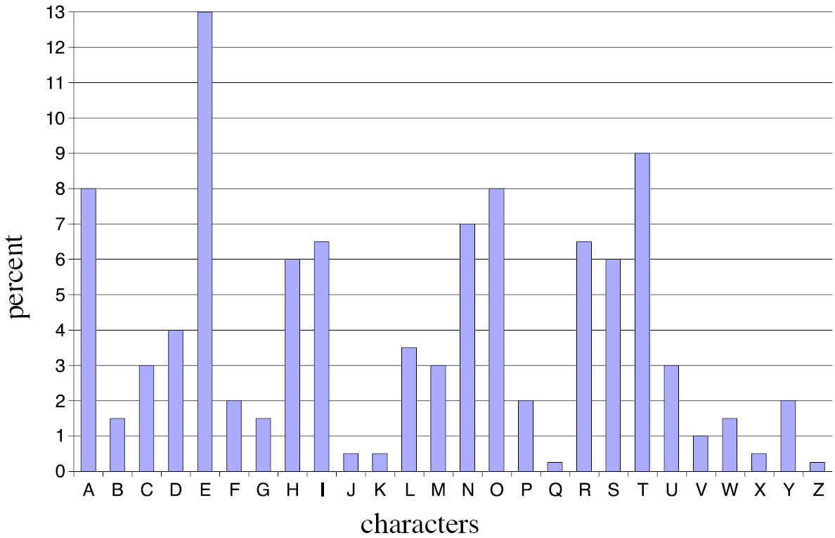





Frequency Analysis
If a cipher preserves the pattern of the plaintext, it is susceptible to the ciphertext-only attack by applying frequency analysis.
source: http://knight.cis.temple.edu/~jfiore/2006/fall/386/handouts/ch2/ch2_part2_4ups.pdf

Slide 36
Takeaways
The rationale of encryption
One-time pad cipher
AES: key size, block sizes
ECB, CBC and CTR mode encryption

